Slide 1
Walchand College of Engineering, Sangli.
Presentation on
Computer Instrumentation
Bashir Najir Jamadar M.Sc. NET

Slide 2
Instrumentation
The art and science of using instruments for measurements or control is known as instrumentation.
Example: Meter boards of a car indicates distance, speed, condition of oil, cooling water, charge of battery etc.
Examples of sophisticated System: In control board of aircraft, in satellite control station, in control cabin of automated process industry.
Instrumentation used mechanical devices: dial gauges, safety values etc.
Mechanical devices » Electromechanical devices » Electronic devices » Modern digital devices (µP, µC, Computers).

Slide 3
Measurement System
A measurement system is a combination of different physical devices which act together as an entire unit to measure certain quantity or parameter of the plant.
Process (Plant)
Primary Element (Sensor, Transducer)
Signal Conditioner
End element / Display
Measurand

Slide 4
Control System
A control system is a combination of different physical devices connected to each together which act as a single unit to control one or more parameters of the plant or process.
Disturbance (N)
Input (R)
+
Set point
error
Plant or Process
Output (C)
Controlled
Variable
Amplifier
Actuator
E=R-B
B
-
Sensor
Feedback Network
Signal Conditioner
Controller
Measuring System

Slide 5
Temperature Control System
Input (R)
+
Set Temperature (50ºC)
Temperature
Controlled
Variable
Controller
Relay
Heater
Room
E
B -
Actuator
Plant
Temperature
Controller
Sensor
Ta
Feedback path
Signal Conditioner
Measuring System

Slide 6
Types of control system
Closed loop system or feedback system.
Feedback type control system provides continuous vigilance over the value of controlled variable.
Example: Automatic temperature control system.
It has dynamic performance, accuracy and adaptability to disturbance.
Open-loop control system.
Example: Remote control of TV.
It is simple, less costly and fast in operation but limited in accuracy.

Slide 7
Intelligent Control System
Disturbance
Input
Computer as Controller
Output (C)
DAC
Actuator
Plant or Process
ADC
Measuring System
Intelligent control system is used in modern chemical process industry. Such systems are provided with the capability of taking their own decisions in setting inputs of controlled variables, depending upon environment and disturbance.

Slide 8
Transducer and Sensor
In Instrumentation, the terms transducer and sensor are interchangeably but there is a slightly between these two.
A sensor may be employed for detecting the status of variable or sensing the degree or level of a physical measurand, apart from responding to the condition under measurement.
Sensor is a device that performs initial measurement and energy conversion, while transducer is a device which converts signal from one form to another form.
Ex: I to V converter would be transducer but not a sensor.
“All sensors are transducers but all transducers may not be sensors.”

Slide 9
Classification of Transducer
Classification of transducer is possible in several way…
1) The measurand they measure
2) Basic phenomenon on which they work
(Principal of transduction)
3) Function they perform (Primary or secondary transducers)
4) Energy requirement (Passive or active transducers)
5) Nature of circuits (Analog or digital transducers)

Slide 10
Classification of Transducer
1. Classification based on measurand:
There are many types of variables required to be measured in the process control industry.
Depending on the process variable or measurand, there are different types of transducers.
Temperature transducer: Thermocouple, RTD, Thermostat etc
Pressure transducer: Bourdan tube, bellows, diaphragm etc.

Slide 11
Classification of Transducer
2. Classification based on the principle of transduction:
Due to change in process parameter, resistance, inductance or capacitance may changes.
Depending on the change of resistance, inductance or capacitance, there are different types of transducers.
Thermistor: resistance of semiconductor material changes with the temperature.
Capacitor microphone: the capacitance of microphone varies with the sound pressure.

Slide 12
Classification of Transducer
3. Primary and Secondary transducers:
Sometimes, more than one transducers are required to measure the process variable.
e.g. Measurement of pressure using Bourdon tube and LVDT.
The Bourdon tube acting as a primary transducer senses the pressure and converts it into a displacement at its free end. The displacement moves the core of LVDT and produces output voltage proportional to the movement of core, which is proportional to the displacement of the free end which in turn is proportional to the pressure.
Bourdon tube: Primary, LVDT: secondary.

Slide 13
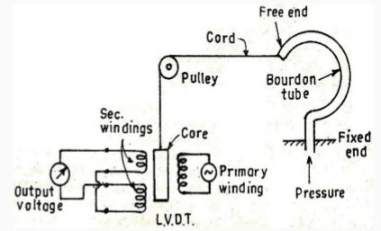
Classification of Transducer
3. Primary and Secondary transducers:
Bourdon tube: Primary, LVDT: secondary.

Slide 14
Classification of Transducer
4. Active and Passive transducers:
Active transducers are self powering devices which do not require external power supply for the conversion from one form to other.
Thermoelectric, piezoelectric, photovoltaic, electromagnetic, electrodynamic, magnetostrictive, electrokinetic, pyroelectric and galvanic sensors.
Piezoelectric crystal: when force is applied across the crystal, an output voltage is produced.
Photovoltaic device produces voltage when illuminated by light.

Slide 15
Classification of Transducer
4. Active and Passive transducers:
Passive transducers operate under energy controlling principles. These are not self generating type and which require external power supply for the conversion from one form to other.
e.g. Resistive, inductive and capacitive transducers.
Any change in these parameters can be recognized only when the element is made live by electric excitation otherwise they are in dead state.
In the absence of external power, the transducer can not be work. e.g. Piezoresistive transducer, Photoconductive device.

Slide 16
Classification of Transducer
5. Analog and Digital transducers:
Analog transducers convert the input quantity into an analog output which is continuous function of time.
e.g. Strain gauge, LVDT, thermocouple, thermistor etc.
Digital transducers convert the input quantity into digital form of output.
e.g. shaft encoder used to measure angular position of shaft, digital tachometer used to measure the speed. Both gives pulses as the output. Frequency or distance between pulses indicates the speed or angular position.

Slide 17
Characteristics of Transducers
1. Range and span:
These are the lower and upper limit values of the measurand.
Range of transducer is the difference between largest and smallest reading of the measurand. Range: X_{min} to X_{max}.
Span of transducer is the algebraic difference between largest and smallest reading of the measurand. Span = X_{max} - X_{min}. (X_{min} may or may not be zero)
If R-type thermocouple measure temperature from 0ºC to 1600ºC, then range is 0 to 1600ºC and span is 1600 – 0 = 1600ºC.
For RT-100 temperature transducer, temperature range is -200ºC to 600ºC while span is 600 – (-200) = 800ºC

Slide 18
Characteristics of Transducers
2. Error:
Error is the algebraic difference between the indicated value (I) and actual or true value (T) of a measurand.
E = I - T
Error may be positive or negative.
It represents the actual value of measurand predicted from the measurement.

Slide 19
Characteristics of Transducers
3. Accuracy:
Accuracy is defined as the closeness with which the reading approaches an accepted standard value or true value.
It is a relative term.
Absolute accuracy has no significance in the measurement.
Usually, percentage accuracy is specified as the percentage deviation or inaccuracy of the measurement from the true value. It is a ratio of error to the true value expressed in percentage.

Slide 20
Characteristics of Transducers
4. Precision:
It is a measure of the reproducibility of the measurement.
Precision is defined as the closeness with which individual measurements are distributed about their mean value.
If the same measurement is done several time, the output value should be same for all the time. But practically, readings are clustered around the mean value. The more number of readings falling very close the value, the more precise the instrument is.
Note: High precision does not indicate high degree of accuracy.

Slide 21
Characteristics of Transducers
5. Linearity:
One of the important characteristic of transducer is linearity.
The output should be linearly proportional to the input.
Linear input-output relation can be written as y = mx + c, where y is the output, x is the input, m be the slope and c be the intercept.
The linearity is expressed as a percentage of the deviation of any point from the idealized straight line.

Slide 22
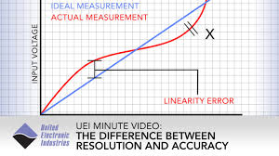
Characteristics of Transducers
5. Linearity:

Slide 23
Characteristics of Transducers
6. Resolution:
If the i/p is very slowly increased from some arbitrary i/p value, it is found that o/p does not change at all until a certain increment is exceeded. This increment is called as resolution.
Resolution is defined as the ability of a transducer to discriminate between nearly equal values. In short it is the smallest measurable input change.
The threshold value of the transducer defines the smallest measurable input. It is the resolution at zero value or the minimum i/p required to make transducer active.

Slide 24
Characteristics of Transducers
7. Hysteresis:
Output of transducer depends upon the past history of input. When a device is used to measure any parameter, first for increasing values of the measurand and then for decreasing values; the two o/p readings of the same i/p may be different.
The difference of o/p readings for same i/p is the hysteresis of the device.
Hysteresis is common in electromagnetic device.
For better accuracy, hysteresis should be minimum.

Slide 25
Characteristics of Transducers
8. Reproducibility:
Reproducibility is the ability of transducer to produce output readings when the same input is applied at different times under different conditions and by different instruments.
It indicates same characteristic behavior of the transducer under different environmental conditions, guaranteeing accuracy even under external distribution or changed condition.

Slide 26
Characteristics of Transducers
9. Repeatability:
The ability of transducer to reproduce output readings, when the same measurand value is applied to it successively, under the same environmental conditions and in the same direction, is called as its repeatability.
It indicates consistency in the readings.
10. Sensitivity:
Sensitivity is defined as the ratio of the changes in the output of a transducer to a change in a value of the measurand.

Slide 27
Characteristics of Transducers
11. Drift:
Drift is a slow variation in the output signal of a transducer with time when the measurand is constant.
Zero drift is defined as the deviation in the transducer output with time from initial value, when the measurand and conditions are constant.

Slide 28
Characteristics of Transducers
12. Dead band:
Dead band is defined as the largest change in the input quantity to which the transducer does not respond.
13. Stability:
The ability of a transducer to retain its performance through out its specified operating life and storage life is known as its stability.

Slide 29
Selection Criteria for Transducers
Purpose of measurement
Nature or type of physical quantity to be measured
Source of measurand
Range of measurand
Order of accuracy and precision required in the measurement
Installation considerations of the transducers
Possibility of overloads during the measurements
Ambient conditions
Life span of transducer
Transduction principle
Limit on excitation and output of the transducer
Availability of transducer
Ease of operation
Right time availability of transducer to meet installation schedule
Cost

Slide 30
Temperature Transducers
Temperature transducer is a device which senses the temperature and convert it into some convenient form of signal.
The choice of temperature transducer depends on the temperature measurement range and the type of application.
The type of temperature transducer based on temperature dependent physical properties.
Mechanical Transducer: Physical change is used to sense the temperature. Expansion of substance (length, volume, pressure) with temperature. e.g. Mercury or alcohol in glass.
Resistance Transducer: Change in electrical resistance with temperature. e.g. RTD, thermistor.
Thermocouple Transducer: Electrical energy is generated by bimetallic junction. e.g. Thermocouple
Radiant energy Transducer: Change in radiant energy with temperature. e.g. Optical and radiation pyrometer.

Slide 31
RTD (Resistance Temperature Detector)
RTD’s are primary, passive temperature transducers whose resistance changes with temperature.
RTD’s are made up of metals which have crystal structure.
Energy Band diagram of metal. Effect of temperature on metal.
RTD has PTC type device whose resistance increases with increase in temperature.
RTD is very accurate and sensitive device and used for the particular temperature range depends temperature coefficient of material and the crystal structure.
Most of the metal shows linear characteristic for small temperature range and slightly non-linear characteristic afterwards.
For narrow range
For large temperature range

Slide 32
RTD (Resistance Temperature Detector)
Materials: Materials can be used for RTD are Nickel, Iron, Copper, Platinum, Silver, Gold, Manganese, Tungsten etc.
Gold and Silver are rarely used due to its low resistivity.
Tungsten has high resistivity, but it is used high temperature applications, as it is extremely brittle and difficult to work with Copper.
Nickel can be used for temperature range of RTD has PTC type device 100ºC to 350ºC. It is reliable, having good repeatability, low cost, and has high temperature coefficient but it is non-linear and drift with time.
Platinum is best for many applications. It is accurate, sensitive, reproducible, highly stable for wide temperature range of -190ºC to 660ºC. It has low temperature coefficient, available in pure form and is relatively unaffected by environmental condition.

Slide 33
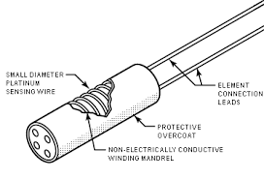
RTD (Resistance Temperature Detector)
Construction: It can be constructed in the form of wire resistors or thin film resistor.
In wire type, RTD consists of coil wound on mica or ceramic former. These coils are available in different sizes and resistance ranging 10Ω to 25 kΩ.
The construction depends on speed of response, environmental condition and ability to withstand vibration.
The wire is wound in the form of coil to achieve small size, improved thermal conductivity and reduce response time.
Thus, RTD is simply length of wire whose resistance is to be monitored as a function of temperature.

Slide 34
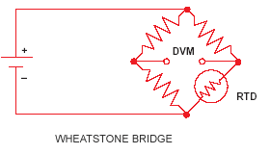
RTD (Resistance Temperature Detector)
RTD Circuit:
The change in resistance has to be converted into voltage or current for the measurement and control.
The electrical power dissipated in the RTD must be limited to avoid errors due to I²R heating of sensor.
The voltage is produced at the output is proportional to the change in resistance of RTD and hence temperature.

Slide 35
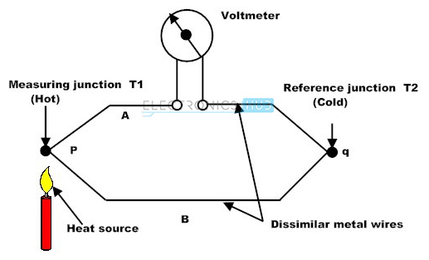
Thermocouple
Thermocouple is a primary, active temperature transducer which converts the change in temperature into emf. i.e. conversion of thermal energy into electrical energy.
The principle of thermocouple is based Seeback effect.
The produced emf is proportional to the difference between two junction temperatures.

Slide 36
Thermocouple
The emf is given by,
e : emf, T₁ & T₂ : Junction temps., Q₁ & Q₂ : Thermal transport constants of two metals.
If the metal are same, the emf is zero. Similarly, if the temperatures are same, the emf is zero.
It is found that, thermal constants of metals are independent of temperature.
ꭤ : Constant in volt, T₁ & T₂ : Junction temps.

Slide 37
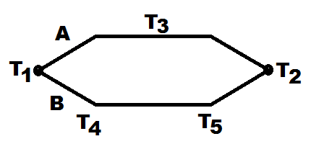
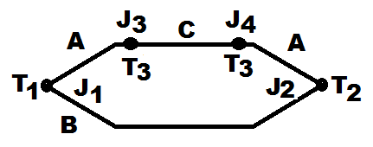
Thermocouple
Thermocouple Laws:
1)
The produced emf depends only on the temperatures of the two junctions and is independent of intermediate temperatures if the two metals used are homogenous.
2)
If a third homogenous metal C is inserted into either A or B, as long as the two new junctions J₃, J₄ are at same temperature, the net emf is unaffected by introduction of metal C.

Slide 38
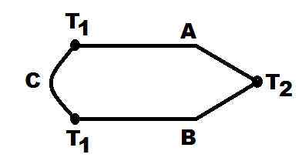
Thermocouple
3)
If metal C is inserted between A and B at one of the junctions, as long as the junctions AC and BC are both at the same temperature, the net emf is the same as if C was not there.
Laws 2 and 3 make it possible to insert a voltage measuring device into circuit to measure the emf. Metal C may represent the multimeter probe. Law 3 also shows that thermocouple junctions may be soldered without affecting the reading.

Slide 39
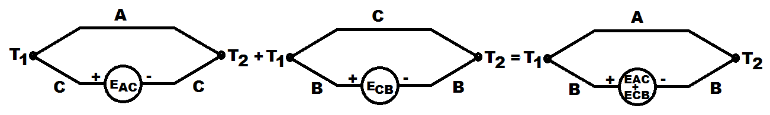
Thermocouple
4)
If the Seeback emf produced by the metals A and C at junction temperature T₁ and T₂ is E_{AC} and that of metals B and C at junction temperature T₁ and T₂ is E_{CB}, then the emf produced by metals A and B is E_{AC} + E_{CB.}

Slide 40
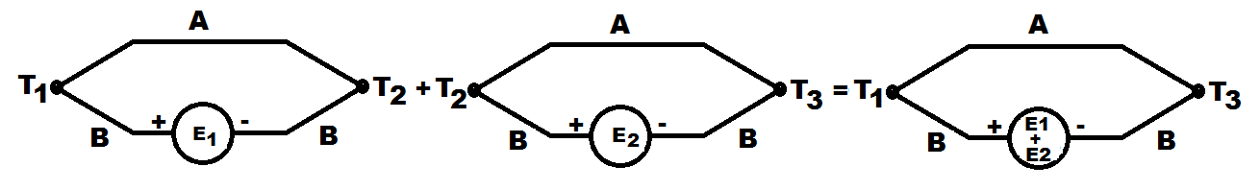
Thermocouple
5)
If the Seeback emf produced by the two metals A and B at junction temperature T₁ and T₂ is E₁ and that C at junction temperature T₂ and T₃ is E₂, then the emf of the thermocouple made up of metals A and B, having junction temperatures T₁ and T₂ is E₁ + E_{2.}

Slide 41
Thermocouple
Type | Materials | Normal Range | Sensitivity (µV/ºC) | Comment
J | Iron-Constanton | -190ºC to 760ºC | 50 | Most widely used in industry
T | Copper-Constanton | -200ºC to 370ºC | 46 | Used for negative temperature measurement
K | Chromel-Alumel | -190ºC to 1260ºC | 42 | Used in non-reducing atmosphere
E | Chromel-Constanton | -100ºC to 1260ºC | 68 | Highest sensitivity
S | 90% Platinum + 10% Rhodium platinum | 0ºC to 1500ºC | 6 | Lowest sensitivity, useful for high temperature measurement.
R | 87% Platinum + 13% Rhodium platinum | 0ºC to 1500ºC | 6

Slide 42
Thermocouple
 | Thermocouple | RTD
Advantages | Self powered | Most stable
 | Simple | Most accurate
 | Rugged | More linear than the thermocouple
 | Inexpensive
 | Wide variety
 | Wide temperature range
Disadvantage | Non-linear | Expensive
 | Low output voltage | Current source required
 | Reference required | Small resistance change
 | Less stable | Self-heating problem
 | Characteristic

Slide 43
Strain Gauge
It is a passive type transducers used for the measurement of strain.
It is very common in process control industry.
Generally, strain gauges are used as secondary transducer along with the primary mechanical transducer to measure the process variables like force, pressure, weight, acceleration etc.
Strain gauge can be classified as mechanical, optical or electrical depending upon the principle of operation and their construction.
When force is applied to the material its dimension changes.
In Mechanical S.G., the change in length Δl is magnified mechanically using levers and gears.
In Optical S.G., the magnification of Δl is achieved with multiple reflectors using lenses, mirrors or prisms.
In Electrical S.G., change in length changes resistance, capacitance or inductance of materials. Out of them Electrical S.G. is popular.

Slide 44
Strain Gauge
When force is applied to the material, its dimension changes.
Applied force per unit area is stress and the resulting deformation per original is the strain.
The resistance of conductor,
Due to tensile force, length as well as area of conductor changes but volume remains constant.
The resistance of conductor changes.

Slide 45
Strain Gauge
The change in resistance
The strain converts itself directly into a resistance change.
The sensitivity of a strain gauge is given by a characteristic called the gauge factor k
Other characteristics are gauge length, gauge width, range of measurement, accuracy, the ambient conditions it can withstand.

Slide 46
Types of Electrical Strain Gauge
According to method of fabrication a) Wire gauge b) Foil gauge.
1) Wire gauge: It can be Bonded or Unbounded type
In first, the strain gauge is bonded directly to the surface of specimen under test by a thin layer of adhesive cement. It transmits the strain from the specimen to the gauge wire.
In second, there is free resistance wire to whom strain is directly transferred without any backing. They are used in displacement, pressure transducer and accelerometer.
2) Foil gauge: In this type, very thin foil of the material is used. It has larger surface area and higher heat dissipation capacity which makes the gauges thermally stable.
Semiconductor strain gauge: Higher strain sensitivity.
Change in resistance is 40 to 100 times more than conventional type. Advantages: Chemical inertness, low hysteresis, good fatigue life etc.

Slide 47
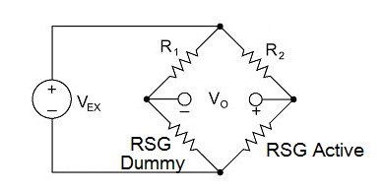
Temperature compensation of Strain Gauge
The change in resistance of a gauge is due to change in strain and change in temperature.
Wheatstone bridge in a signal conditioner

Slide 48
Pressure Transducer
Pressure: Important variable is to be monitored or controlled in PCI. It is force per unit area at given point or over the surface.
Types: Gravitational and elastic.
Gravitational: Manometer device is used.
Elastic: Initially pressure is converted into displacement or strain and then it is converted into electrical signal. Diaphragm, capsule, bellow are used for conversion of pressure to strain. Electrical pressure transducers based on principle of transduction are used for conversion of strain to electrical signal.
Example: Pressure Trans. : Elastic element (Primary), Strain gauge (Secondary). It is simple and has good dynamic response.
Thin circular plate stretched and fixed at its periphery.
Made up of metal alloys as bronze, phosphor bronze, stainless steel.
Thickness & size of plate decides range of pressure to be measured.

Slide 49
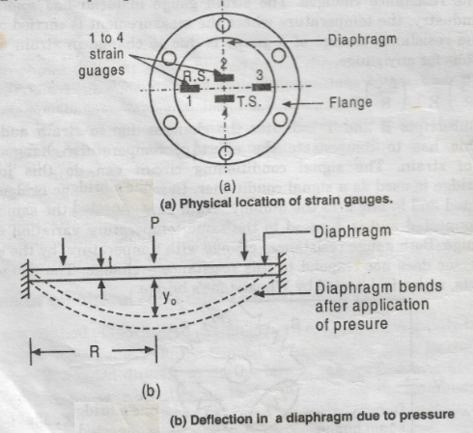
Pressure Transducer

Slide 50
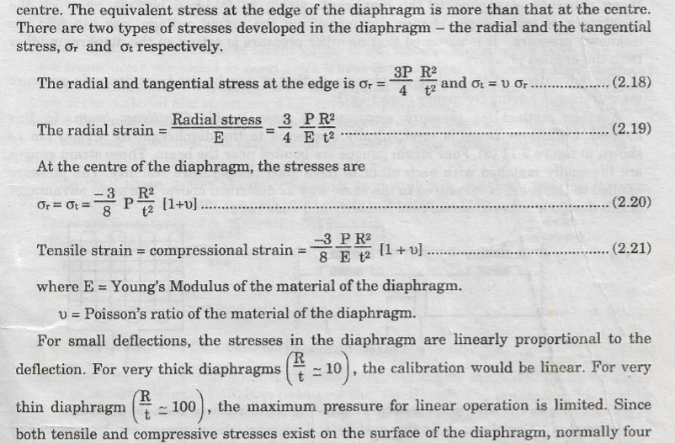
Pressure Transducer

Slide 51
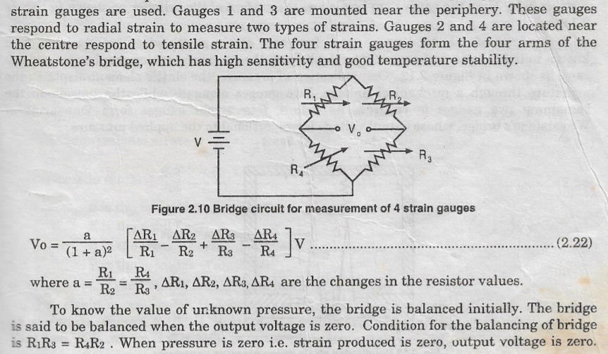
Pressure Transducer

Slide 52
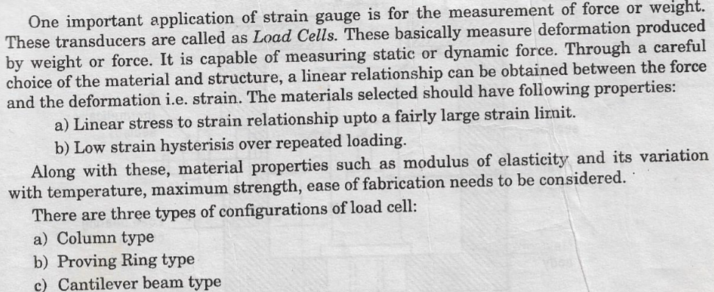
Force Transducer

Slide 53
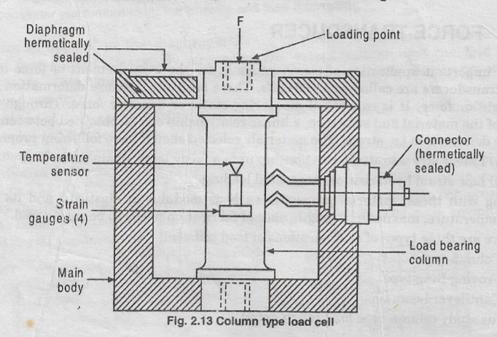
Force Transducer

Slide 54
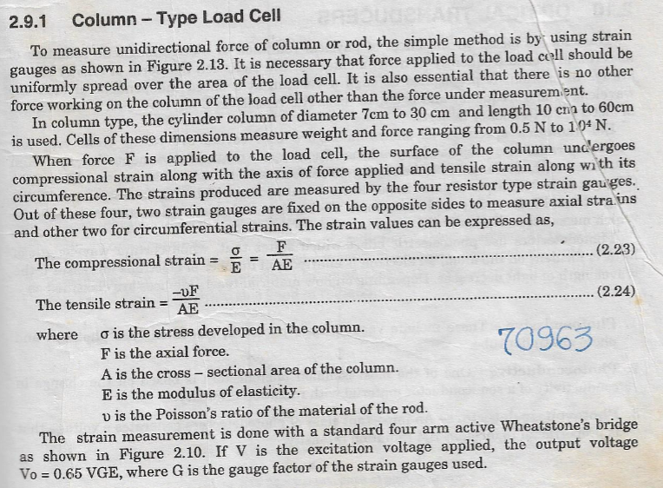
Force Transducer

Slide 55
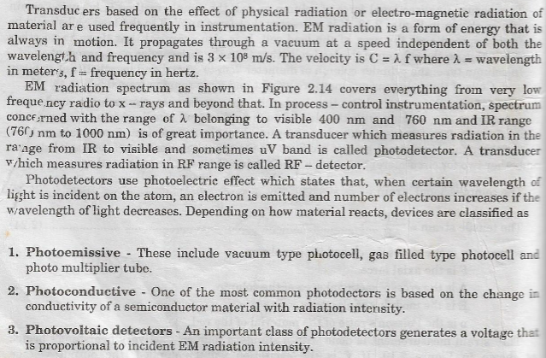
Optical Transducer

Slide 56
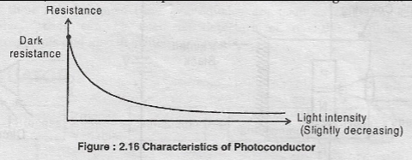
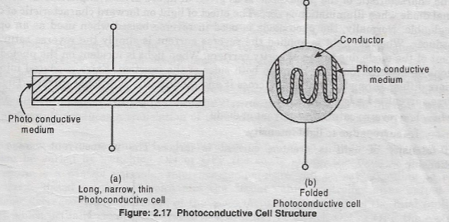
Photoconductor

Slide 57
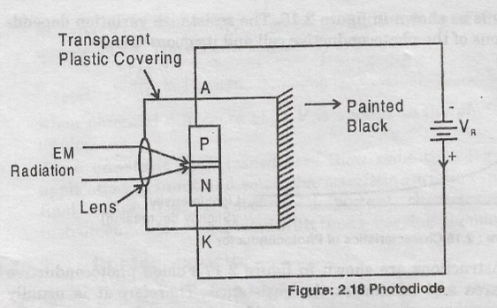
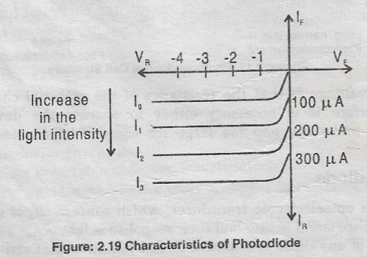
Photodiode

Slide 58
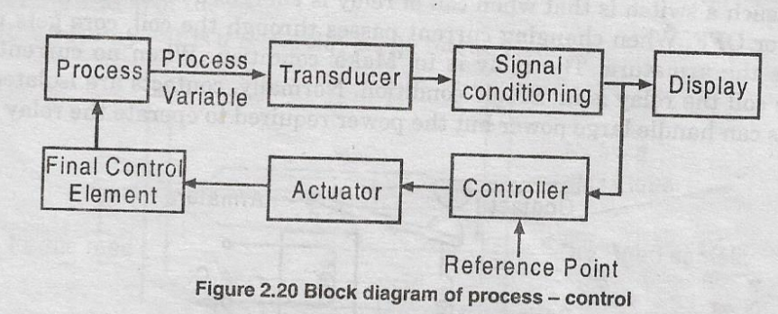
Actuators
Types: 1. Electrical
2. Pneumatic
3. Hydralic

Slide 59
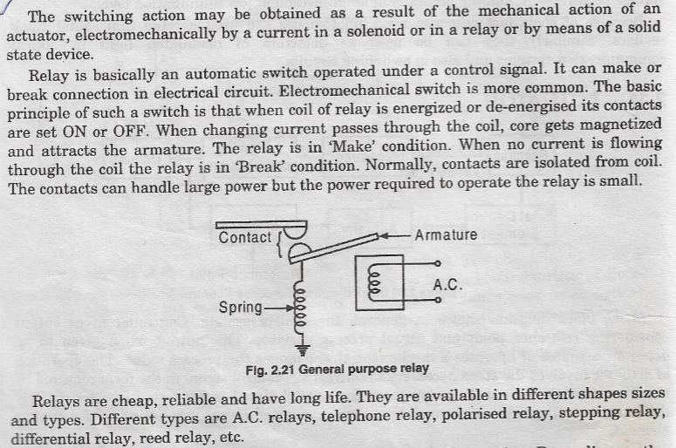
Relay

Slide 60
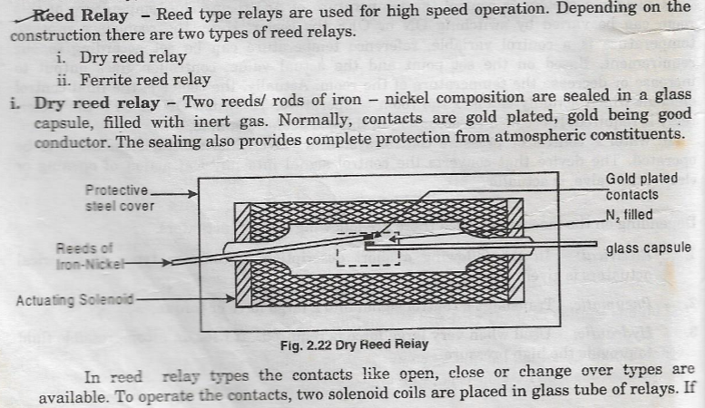
Relay

Slide 61
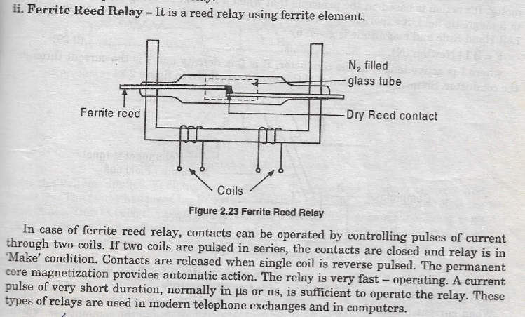
Relay

